Slide 1
Management Practices and Mergers and Acquisitions
John (Jianqiu) Bai, Wang Jin, Matthew Serfling (2022)
Presented by Nicholas Thompson

Slide 2
Research Question
How do management practices contribute to value creation in mergers and acquisitions?

Slide 3
Prior Literature
Firms and establishments with more structured management practices perform better on metrics such as productivity, profitability, growth, and longevity (e.g., Bloom and Van Reenen 2007, Bloom et al. 2013a, Sadun et al. 2017).
Firms and establishments with higher management scores have higher market valuations, profitability, productivity, value added, growth, survival rates, and innovation (Bloom et al. 2013b, Bloom et al. 2019).
Work on the role of managers and M&A deal success:
Gains from M&A are largest when high-Q firms acquire low-Q firms (Lang et al. 1989, Servaes 1991).
Wang and Xie (2009) and Masulis et al. (2007) find larger M&A gains when firms with stronger shareholder rights acquire firms with weaker shareholder rights.
Notes:
Structured management practices are those that are more specific, formal, frequent, or explicit (e.g., having more key performance indicators, clearly displayed production targets, and compensation more explicitly tied to a worker’s performance).

Slide 4
Data
U.S. Census Bureau’s 2010 Management and Organizational Practices Survey (MOPS)
Questions about management practices in 2010 and 2005
Census Bureau’s Longitudinal Business Database (LBD)
Annual coverage for all business establishments in the U.S. with at least one paid employee
Final sample: 14,000 establishment-level observations in 2010

Slide 5
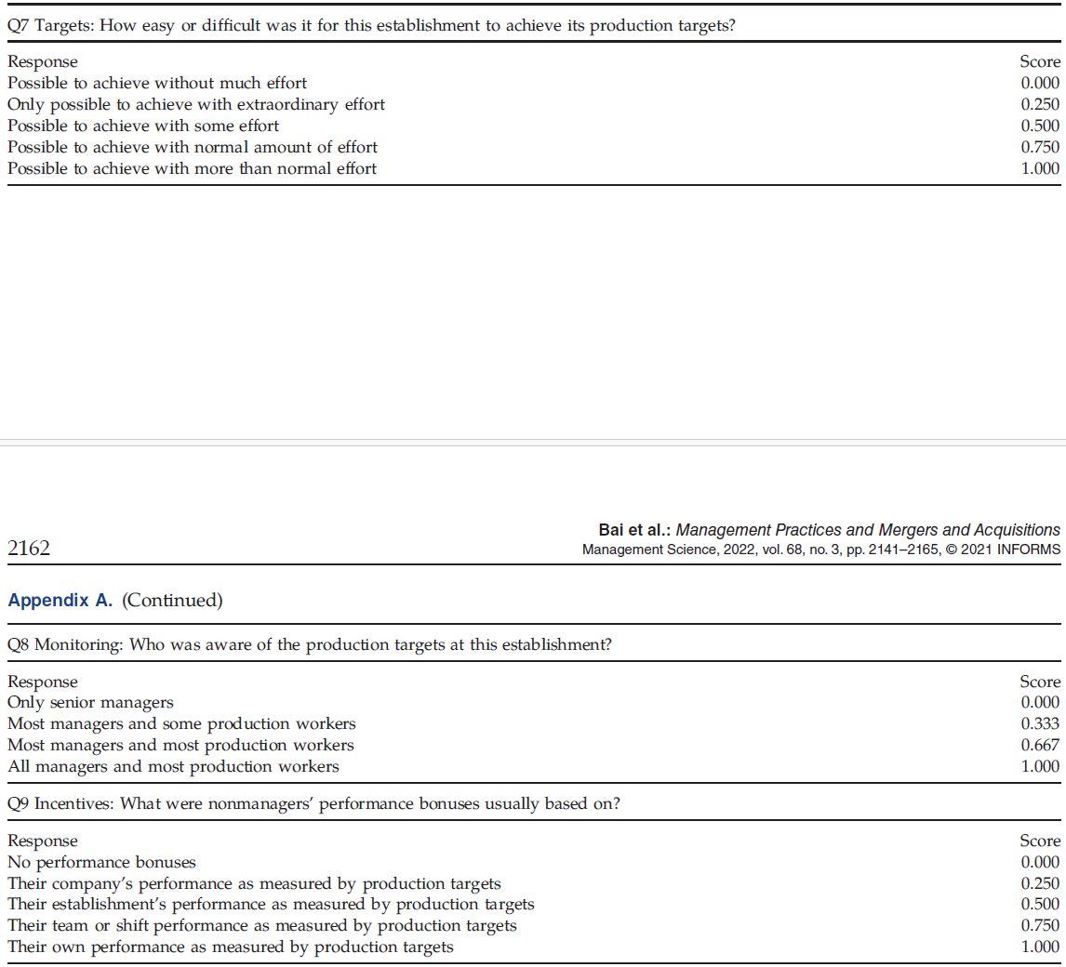
Notes:
Three example questions out of 16 from “Appendix A. MOPS Questions”
Three categories of questions scored from 0 (least structured) to 1 (most structured): Targets, Monitoring, and Incentives

Slide 6
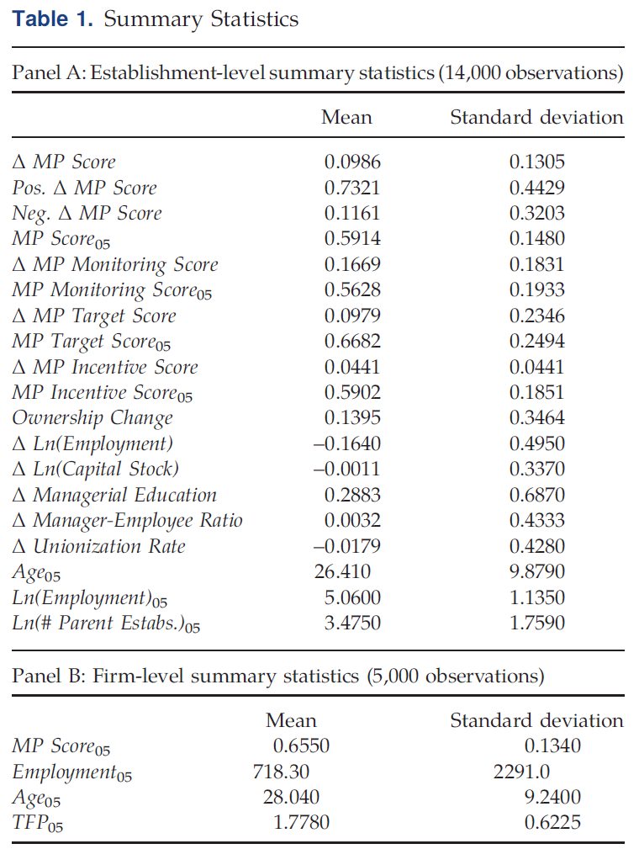
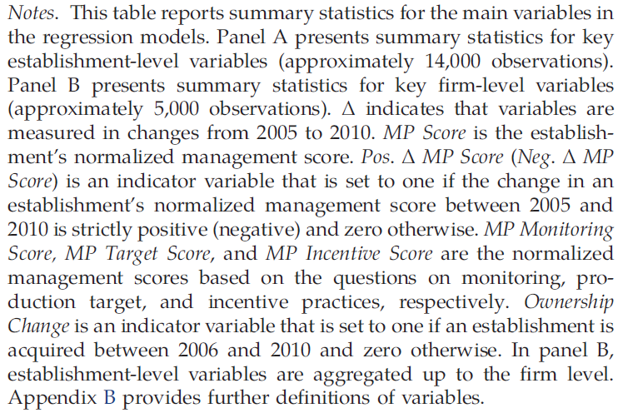
Notes:
The overall management practices score in 2005 was 0.59 on average.
Establishments had the most structured management practices related to targets with a value of 0.67 and the least structured management practices related to monitoring with a value of 0.56.
On average, management practices became more structured between 2005 and 2010, with an increase of 16.7% (= 0.0986/ 0.5914) in the overall management practices score.
14.0% experienced an ownership change.
Employees shrunk by 16.4% and capital stock shrunk by less than 1%.

Slide 7
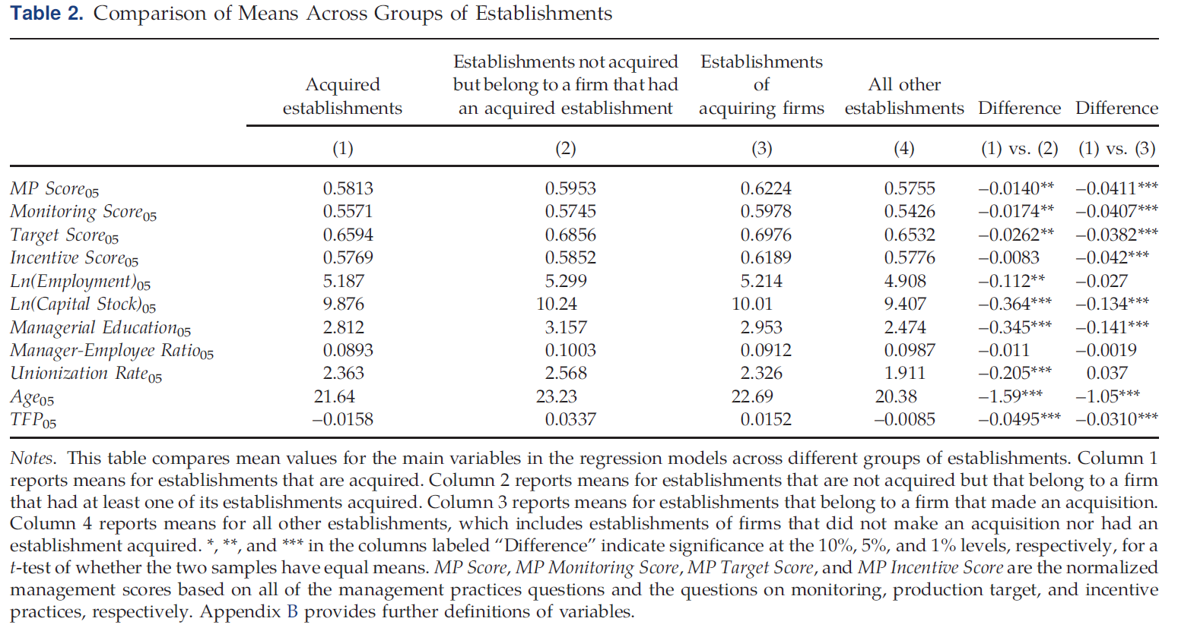
Notes:
Differences in columns 1 and 2: Acquired establishments have lower management scores, fewer employees and physical assets, less-educated managers, and lower union membership rates. They are also younger and less productive.
Differences in columns 1 and 3: Acquiring-firm establishments have higher management scores, more physical assets, and more educated managers. They are also older and more productive.

Slide 8
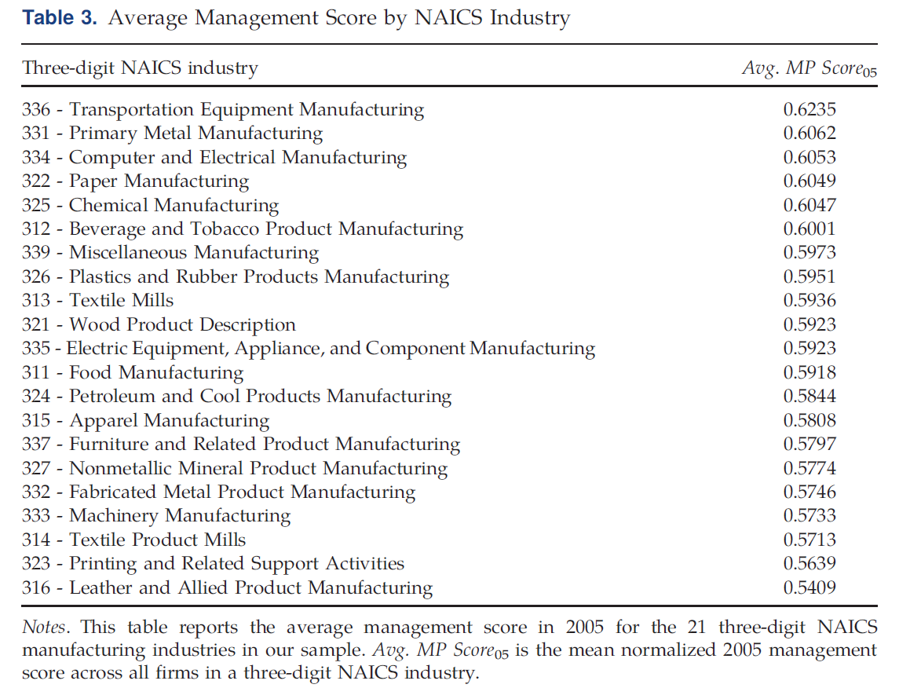
Notes:
There are not substantial differences in the management practices of establishments in different industries.
Most structured: “Transportation Equipment Manufacturing,” with an average management score of 0.624.
Least structured: “Leather and Allied Product Manufacturing,” with an average management score of 0.541.
For context, the standard deviation of management scores across all establishments is 0.148.

Slide 9
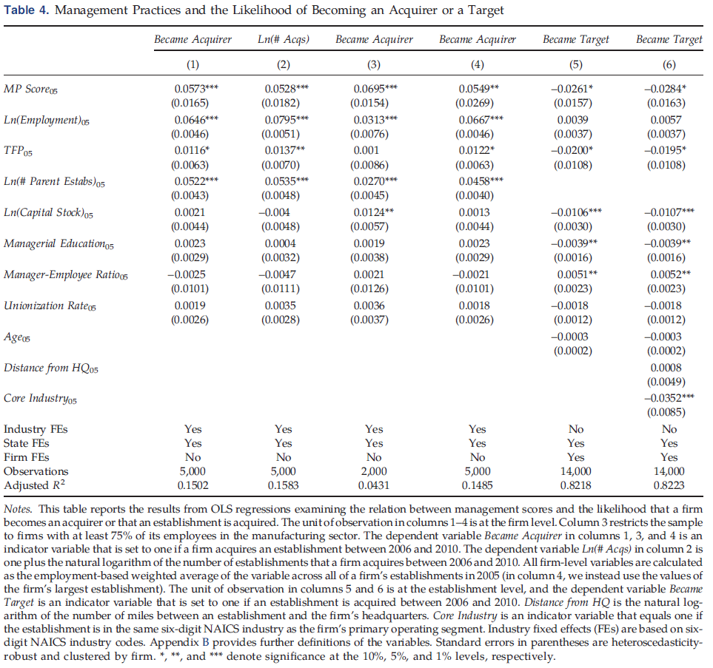
Notes:
This table reports the results from OLS regressions examining the relation between management scores and the likelihood that a firm becomes an acquirer or that an establishment is acquired.
Columns 1 and 2 show a show a positive and statistically significant relation between a firm’s management score and the likelihood that it becomes an acquirer, as well as the number of acquisitions it makes.
Column 3 repeats the analysis in column 1 but restricts the sample to firms that have at least 75% of their employees working for establishments in the manufacturing sector.
Column 4 repeats the analysis in column 1 but uses the characteristics of a firm’s largest establishment instead of an average across all establishments.
Columns 5 and 6 show a negative and statistically significant relation between an establishment’s management score and the likelihood that it is acquired.

Slide 10
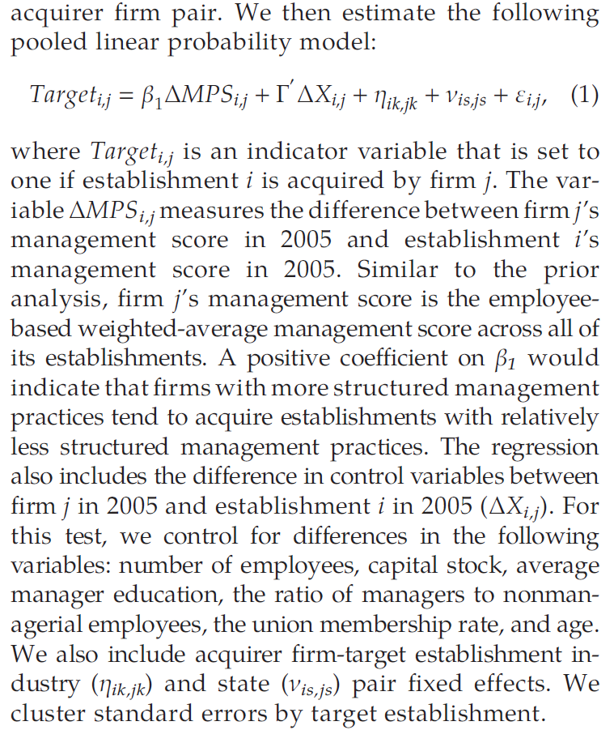

Slide 11
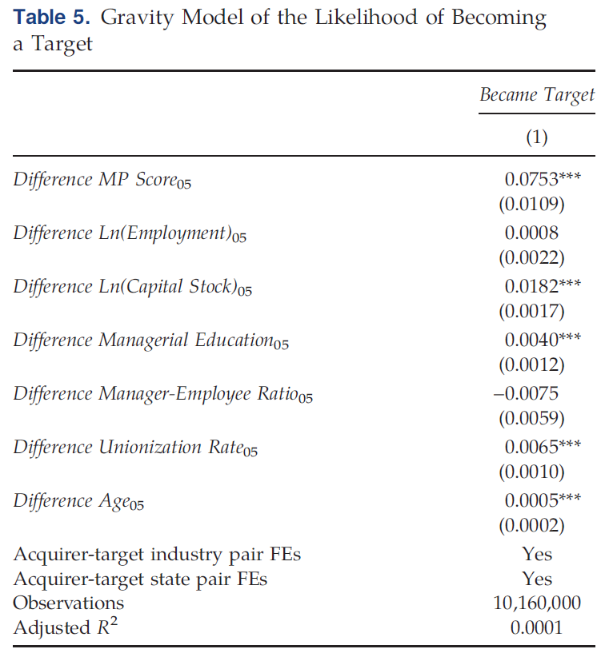
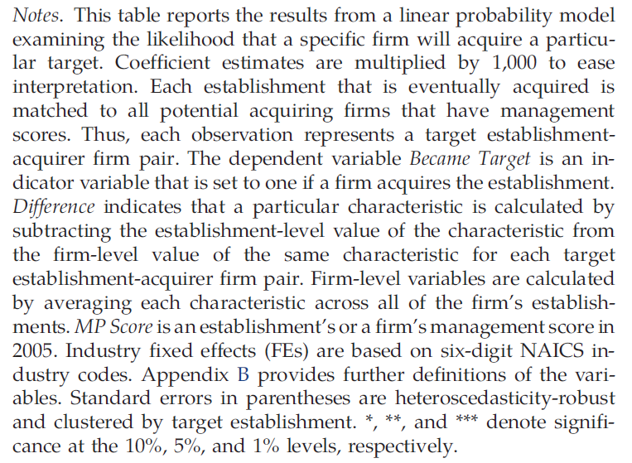
Notes:
The dependent variable Became Target is an indicator variable that is set to one if a firm acquires the establishment.
Consistent with the results in Table 4, the authors find that firms with higher management scores tend to acquire establishments with lower management scores.

Slide 12
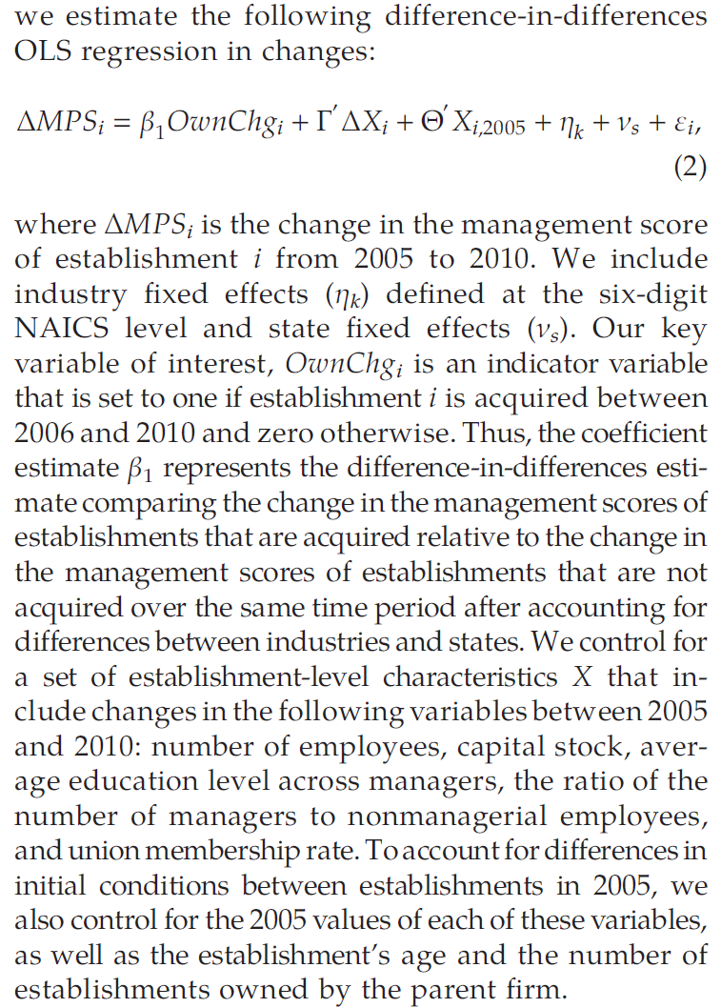

Slide 13
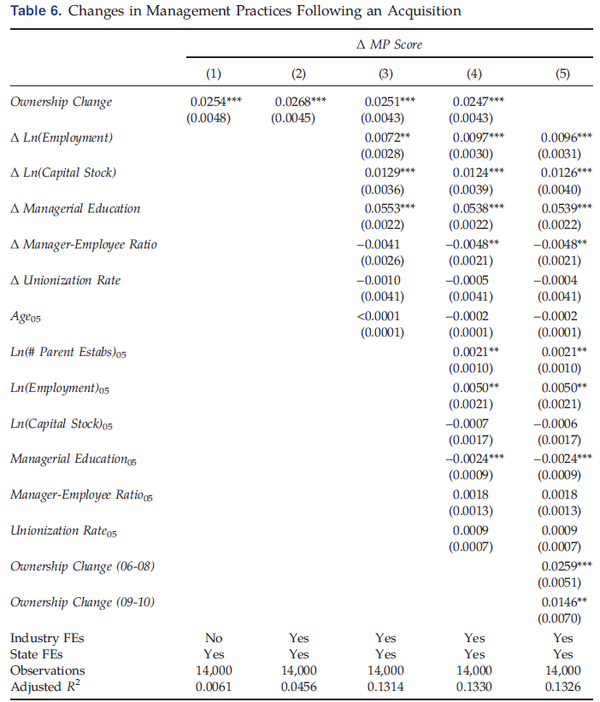
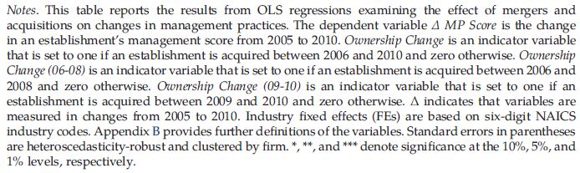
Notes:
The dependent variable Δ MP Score is the change in an establishment’s management score from 2005 to 2010.
Column 1 presents the results from a regression with state fixed effects but no other control variables. The regressions in columns 2–4 sequentially add control variables, with column 2 adding industry fixed effects, column 3 adding establishment-level control variables in changes and establishment age, and column 4 adding the other initial establishment conditions.
Across all these models, the results show that acquired establishments adopt more structured management practices.

Slide 14
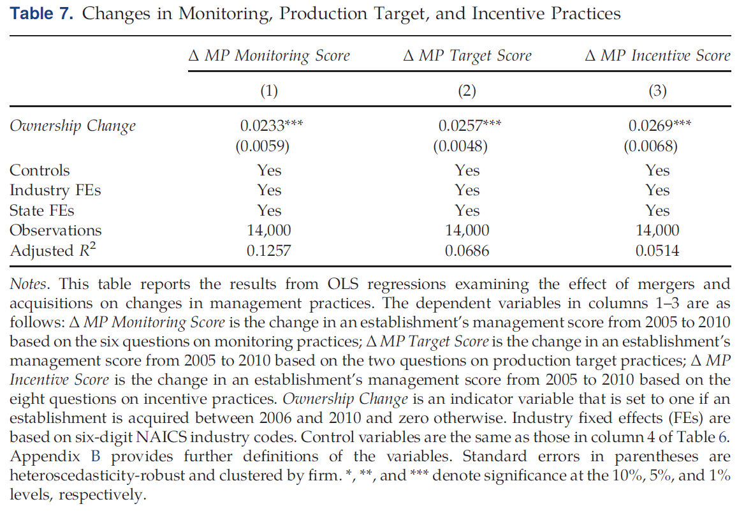
Notes:
Table 7 examines the effect of M&A on each of the three categories of management practices separately.
Like the last table, Δ MP is the change in an establishment’s management score from 2005 to 2010.
The authors find significant increases in the management scores in each of the three categories of management practices after an acquisition.

Slide 15
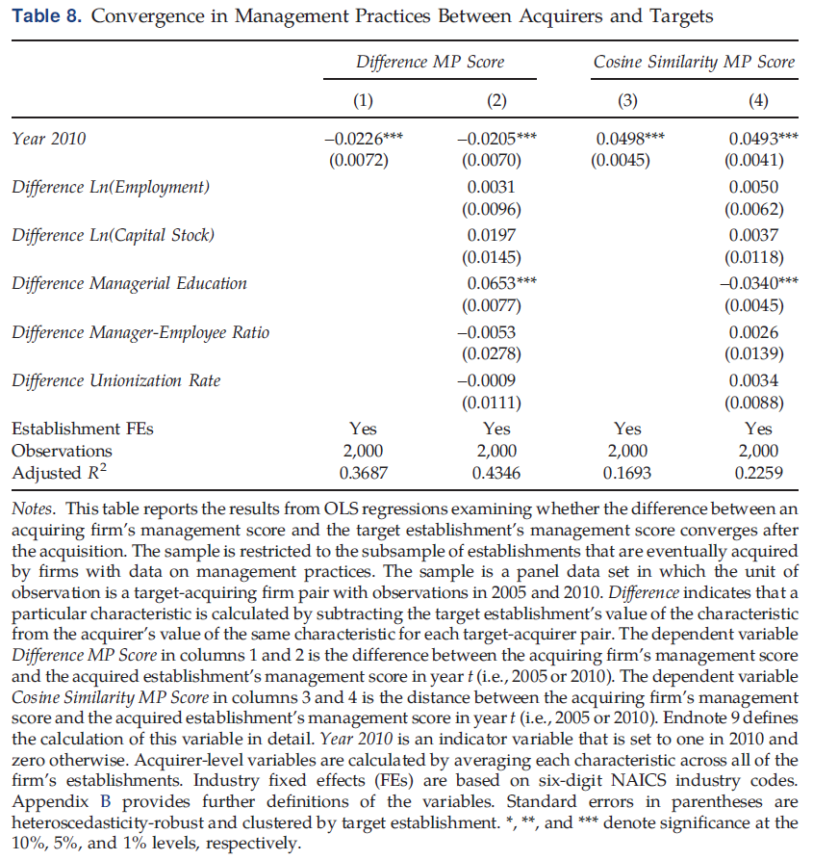
Notes:
Difference MP Score in columns 1 and 2 is the difference between the acquiring firm’s management score and the acquired establishment’s management score in year t.
The dependent variable Cosine Similarity MP Score in columns 3 and 4 is the distance between the acquiring firm’s management score and the acquired establishment’s management score in year t.
The results show that the target’s management practices converge to those of the acquirer’s incumbent establishments.

Slide 16
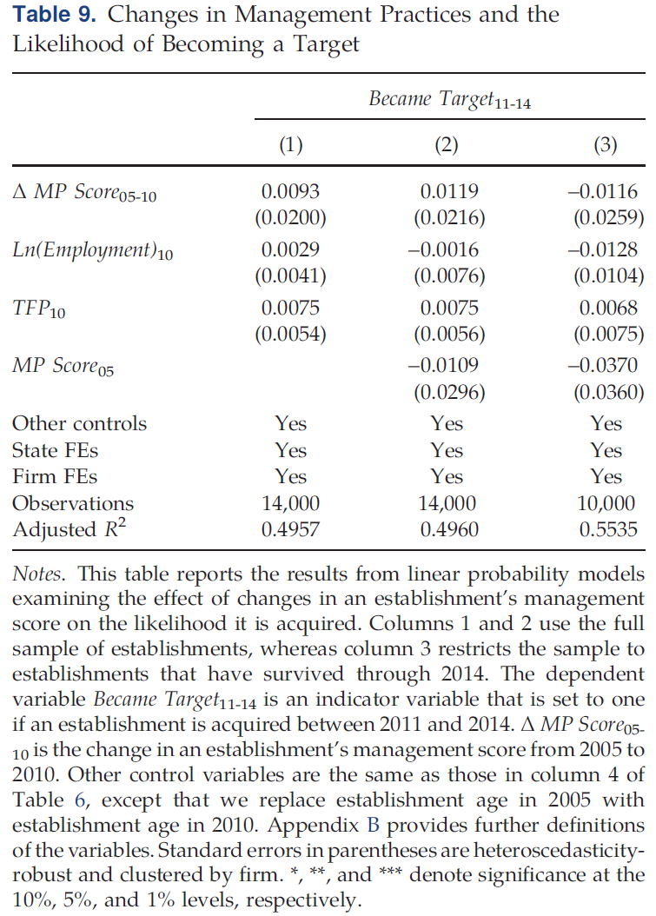
Notes:
The primary identification threat is if these changes are a continuation of a pre-existing trend where acquirers tend to purchase establishments that are already adopting more structured management practices.
The authors conduct an out-of-sample test.
Specifically, the authors examine whether changes in the management scores of establishments between 2005 and 2010 predict whether the establishments are acquired between 2011 and 2014.
Overall, the results in all three columns show a statistically insignificant relation.

Slide 17
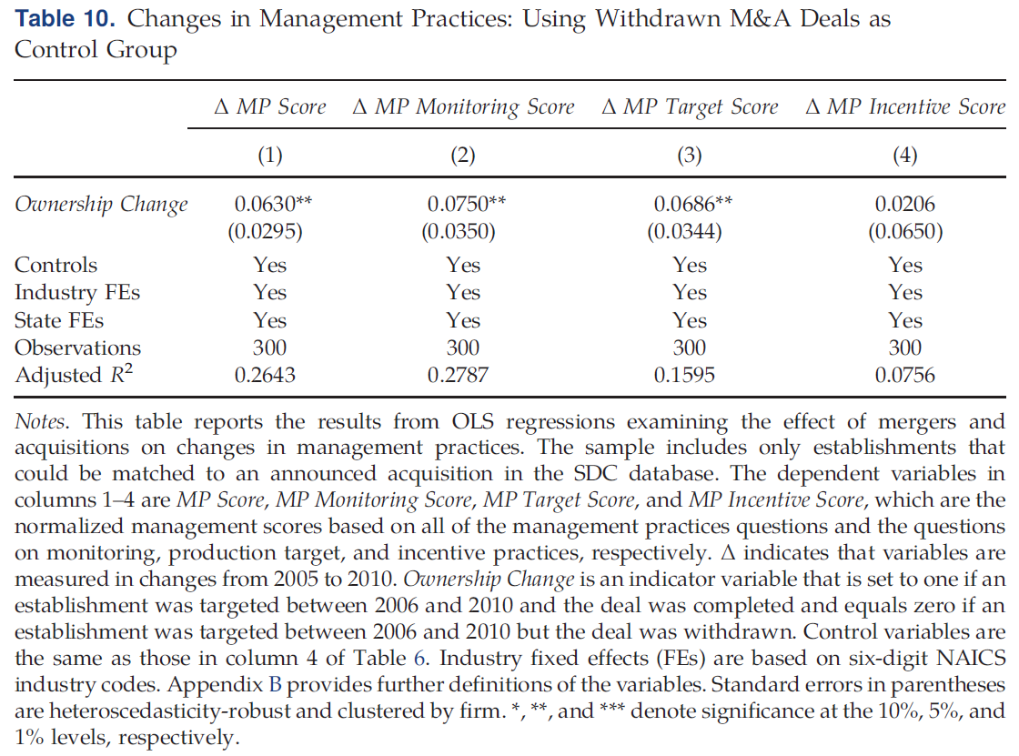
Notes:
Focusing on only targeted establishments helps alleviate the concern that the observed changes in management practices following an acquisition are due to selection effects and differences between targeted and nontargeted establishments.
The coefficient estimate on Ownership Change represents how much management scores change in establishments that are acquired relative to the change in management scores of targeted establishments that are not subsequently acquired.
The results are consistent with the authors’ full sample results.

Slide 18
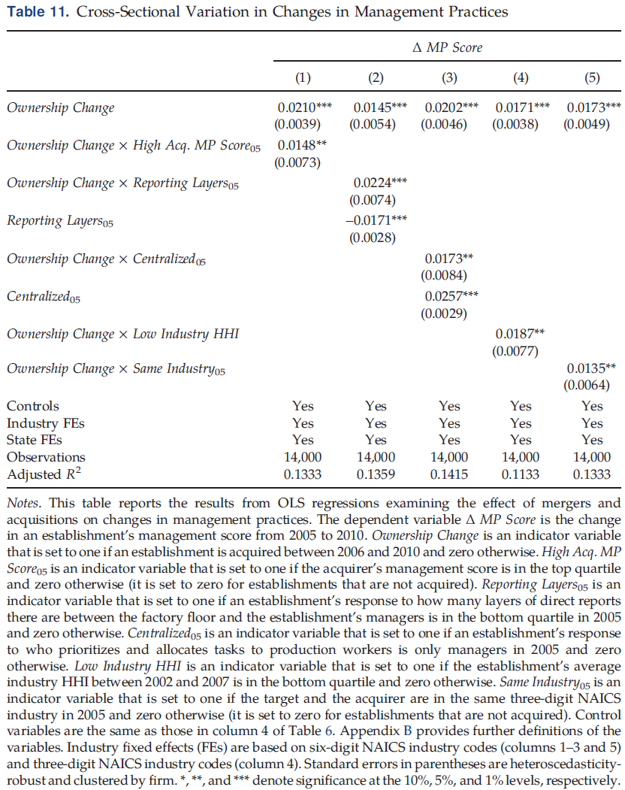
Notes:
Column 1: Relative to acquirers with lower management scores, acquirers with higher management scores adopt even more structured management practices at target establishments.
Columns 2 and 3: Acquired establishments adopt even more structured management practices when managers have a greater ability to make decisions and influence organizational change.
Column 4 shows a larger increase in the management scores of acquired establishments that are in more competitive industries.
Column 5: Acquired establishments adopt even more structured management practices when an acquirer and a target have complementary operations.

Slide 19
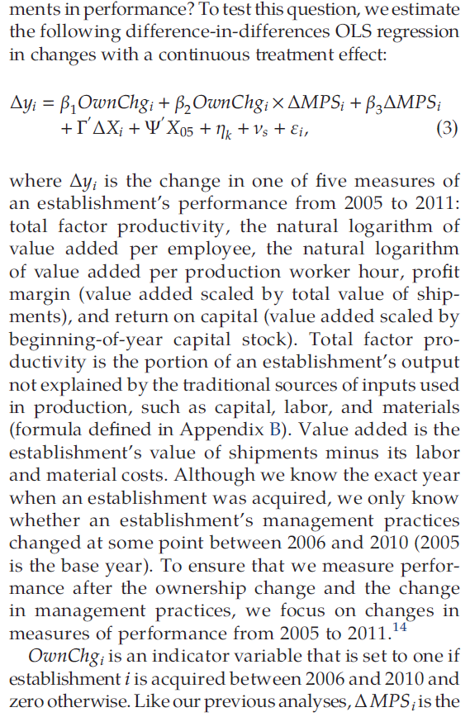
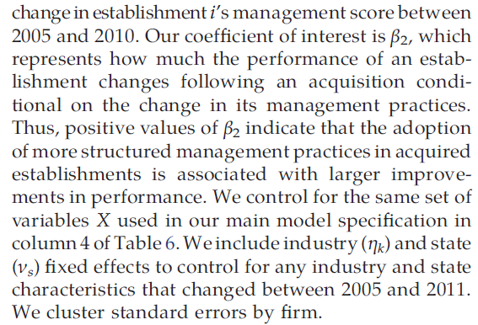

Slide 20
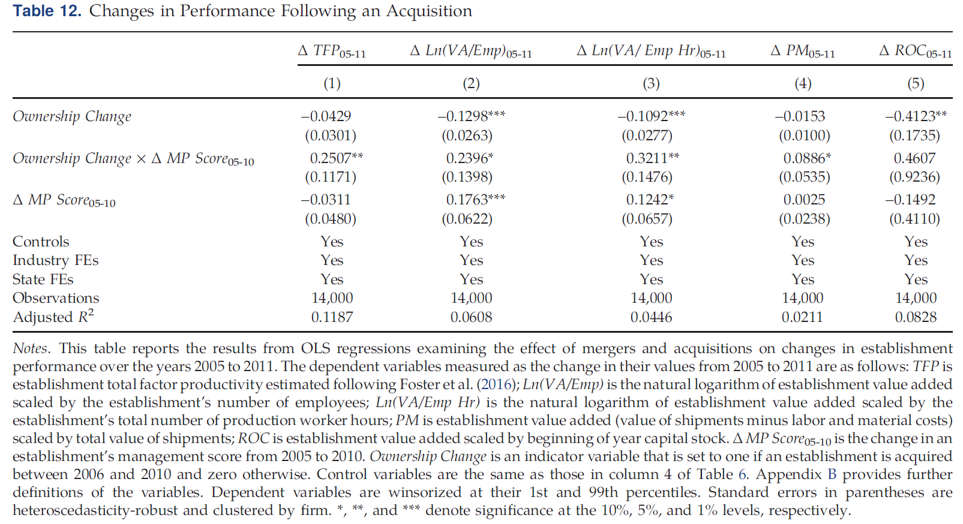
Notes:
In four out of five measures, adoption of more structured management practices following an acquisition is associated with improvements in performance.

Slide 21
Conclusion
Firms with more structured management practices tend to acquire establishments with relatively less structured management practices.
The target’s management practices converge to those of the acquirer’s incumbent establishments.
Changes are greater when acquirers have a greater incentive and ability to make changes.
Post-acquisition improvements in performance are larger when acquired establishments adopt more structured management practices.

